Slide 1


Department of Computer Science and Engineering
CO2 EMISSION RATING BY VECHICLES USING DATA SCIENCE TECHNIQUE
Dhanushpriya T (211419104059)
Jecintha T (211419104112)
Guide Name & Designation
Mrs. S.T. Santhanalakshmi M.Tech.,
Coordinator Name & Designation
Dr. Kavitha Subramani M.E, Ph.D.,

Slide 2
ABSTRACT
Our personal vehicles are a major cause of global warming. Collectively, cars account for nearly one-fifth of all emissions, emitting around 24 pounds of carbon dioxide and other global-warming gases for every gallon of gas. About five pounds comes from the extraction, production, and delivery of the fuel, while the great bulk of heat-trapping emissions-more than 19 pounds per gallon-comes right out of a car's tailpipe A typical passenger vehicle emits about 4.6 metric tons of carbon dioxide per year. This number can vary based on a vehicle's fuel, fuel economy, and the number of miles driven per year. The higher the number of the controlled and uncontrolled effect variables that influence the co2 properties, the lesser the predicted accuracy. Despite this, a few experimental designs have been suggested by considering the controllable effect variables and interaction terms between them. To predict the emission of gas from cars we Supervised machine learning technique which is one of the great technique for predicting the CO2 emission rating. We have used Random Forest algorithm to get a best accuracy rate. In our model, the user will sign up into the user page to get to know about the CO2 emitted in the vehicle that the user has been using. The user will enter the relevant details and the output will be predicted. The predicted out will be displayed in the CO2 control inspector login page, where the inspector give feedback to the user in order to reduce the emission rate of the CO2 gas. The user interface provides a better understanding to our model.

Slide 3
Literature Survey
YEAR | AUTHOR(S) | PAPER TITLE | METHODOLOGY | MERITS/ DEMERITS | FUTURE SCOPE
2022 | Tao Jia; Pengcheng Zhang; Biyu Chen | A Microscopic Model of Vehicle CO₂ Emissions Based on Deep Learning—A Spatiotemporal Analysis of Taxicabs in Wuhan, China Volume: 23 Issued on: 10, October 2022 Journal:: IEEE Transactions on Intelligent Transportation Systems | This study aims to fill this gap by contributing a deep learning-based vehicle emission model (DL-VEM) for estimating instantaneous CO2 emissions with high accuracy. Experiments were conducted in Wuhan, China. Our model was firstly trained and validated using an observed dataset, and it was compared with the state-of-the-art emission models in terms of accuracy. | Merits: Instantaneous vehicle emissions are not only related to current vehicle driving conditions but can be affected significantly by the historical driving conditions Demerits: These models tend to make a balance between simplicity and accuracy, and the estimated emissions may have a low accuracy. | Vehicle CO2 emissions can be significantly affected by different fuel types. To improve the applicability a highly accurate estimation must be performed.

Slide 4
Literature Survey
YEAR | AUTHOR(S) | PAPER TITLE | METHODOLOGY | MERITS/ DEMERITS | FUTURE SCOPE
2019 | A. Jaworski, M. M adziel, and K. Lejda | Creating an emission model based on portable Emission measurement system for the purpose of a Roundabout Vol:26 Issued on:26,2019 Journal:Environmental Science and Pollution Research | Due to the specific traffic conditions that prevail at the roundabout(acceleration, braking, acceleration to a certain speed), the methodology for creating an exhaust emission model for this type of objects has been proposed. | Merits: It issued to identify areas of increased emission of harmful exhaust components. Demerits: It causes prolonged time losses, long queues, and changes in vehicle speed cycles. | It is important to create calculation models of exhaust emissions from vehicles to find out where the roundabouts reach the largest accumulation of pollutants, which will allow for better placement

Slide 5
Literature Survey
YEAR | AUTHOR(S) | PAPER TITLE | METHODOLOGY | MERITS/ DEMERITS | FUTURE SCOPE
2021 | T. Jia, P. Yan | Predicting Citywide Road Traffic Flow Using Deep Spatiotemporal Neural Networks Volume:22 Issued on:5,2021 Journal:IEEE(Institute of Electrical and Electronics Enginerers) | New deep neural networks have been developed to model traffic flow, but it is very challenging to Predict citywide trafficflow at the road level infine temporal scale owing to the influence of spatiotemporal dependencies and spatial sparsity | Merits: It achieves higher accuracy in both single and multi-step traffic flow prediction tasks. Demerits: The random matching conversion simply assigns a road segment to a randomly selected unoccupied image pixel, and it continues until all the road segments have been mapped to the corresponding | Prediction accuracy can be improved by around 6% in terms of RMSE for single step ahead prediction.

Slide 6
Literature Survey
YEAR | AUTHOR(S) | PAPER TITLE | METHODOLOGY | MERITS/ DEMERITS | FUTURE SCOPE
2021 | T. Jia, P. Yan | Predicting Citywide Road Traffic Flow Using Deep Spatiotemporal Neural Networks Volume:22 Issued on:5,2021 Journal:IEEE(Institute of Electrical and Electronics Enginerers) | New deep neural networks have been developed to model traffic flow, but it is very challenging to predict citywide traffic flow at the road level in fine temporal scale owing to the influence of spatiotemporal dependencies and spatial sparsity | Merits: It achieves higher accuracy in both single and multi-step traffic flow prediction tasks. Demerits: The random matching conversion simply assigns a road segment to a randomly selected unoccupied image pixel, and it continues until all the road segments have been mapped to the corresponding | Prediction accuracy can be improved by around 6% in terms of RMSE for single step ahead prediction.

Slide 7
Literature Survey
YEAR | AUTHOR(S) | PAPER TITLE | METHODOLOGY | MERITS/ DEMERITS | FUTURE SCOPE
2020 | C.-H. Hu, Y. Zhang, F. Wu, X.-B. Lu, P. Liu, and X.-Y. Jing, | Toward Driver Face Recognition in the Intelligent Traffic Monitoring Systems Voulme:21 Issued on:12,2020 Journal:IEEE(Institute of Electrical and Electronics Engineers) | A generalized illumination robust (GIR) model based on positive and negative illumination invariant units to tackle severe illumination variations. Then, the GIR model can be used to generate several GIR images based on the local edge-region or the local block-region, which results in the edge-region based GIR | Merits: The proposed GIR model is efficient to severe illumination variations. Demerits: For multi GIR images based classification, the GIR images employ the extended sparse representation classification (ESRC) as the classifier that can form the EGIR image based classification (GIRC) and the | GIR-PDL model may also improve the performance of the deep learning model trained by the driver face images

Slide 8
Literature Survey
YEAR | AUTHOR(S) | PAPER TITLE | METHODOLOGY | MERITS/ DEMERITS | FUTURE SCOPE
2018 | Jinlei Zhang, Feng Chen, Zijia Wang, Rui Wang and Shunwei Shi | Spatiotemporal Patterns of Carbon Emissions and Taxi Travel Using GPS Data in Beijing Issue : 27 February 2018 | First, processed the taxi GPS data Second, using the carbon emission calculation model based on a taxi fuel consumption algorithm. Finally, a visualization method called kernel density analysis is applied. | This study uses taxi GPS data to reconstruct taxi trajectories in Beijing. this study is most applicable to urban planning, infrastructure design, and the transformation of traffic modes, such as the adoption of public transport or electric vehicles to advocate low-carbon trips. | It is difficult to identify the start and end time of idling using taxi trajectory data. In addition, acceleration and deceleration are not taken into consideration.

Slide 9
Literature Survey
YEAR | AUTHOR(S) | PAPER TITLE | METHODOLOGY | MERITS/ DEMERITS | FUTURE SCOPE
2019 | Lakshay Amarpuri; Navdeep Yadav; Girish Kumar; Saurabh Agrawal | Prediction of CO2 emissions using deep learning hybrid approach | The prediction technique used is a deep learning hybrid model of Convolution Neural Network and Long Short-Term Memory Network (CNN-LSTM). | The local and spatial features are directly learned from the convolution and max pooling layers and then the time-series information is extracted with the help of LSTM layers. Finally, a hidden fully connected layer and an output layer are stacked to predict the emission levels of co2 | Future research in this area can be directed to analyze the explicit relation between factors such as population, GDP, economy, etc. and CO2 emissions.

Slide 10
Literature Survey
YEAR | AUTHOR(S) | PAPER TITLE | METHODOLOGY | MERITS/ DEMERITS | FUTURE SCOPE
2019 | Sandeep Kumar, Pranab K. Muhuri | A novel GDP prediction technique based on transfer learning using CO₂ emission dataset Published in: science direct | This paper reports a novel transfer learning based approach for GDP prediction, which we have termed as ‘Domain Adapted Transfer Learning for GDP Prediction. | Merits: A transfer learning based novel GDP prediction method using CO₂ emission data.It can estimate GDP even when macroeconomic data of a nation is unavailable. Demerits: the proposed approach is used to reliably estimate the missing per capita GDP of some of the war-torn and isolated countries. | Future study must focus on using more than three regression methods. To analyse astly nonlinear relationships, soft computing techniques has been quite effective as they can predict a compact solution for multi-variable parameters

Slide 11
Proposed System
The data was collected through online resources to establish the project. such as some independent features. After collecting datasets from various resources, the dataset must be preprocessed before training to the model. The data preprocessing can be done in various stages, beginning with reading the collected dataset the process continues to data cleaning. In data cleaning the datasets contain some redundant attributes, those attributes are not considered for CO2 emission prediction. So, we have to drop unwanted attributes and datasets containing some missing values. We need to drop these missing values or fill them with unwanted nan values in order to get better accuracy. Statistical algorithms and machine learning techniques to identify future outcomes based on historical data. The goal is to go beyond knowing what has happened to provide the best assessment of what will happen in the future. In our system, we used a supervised machine learning algorithm having subcategories as classification and regression. The classification algorithm will be most suitable for this system.

Slide 12
Software / Hardware used
Software Requirements
Operating System : Windows
Tool : Anaconda with Jupyter Notebook
Hardware requirements
Processor : Pentium IV/III
Hard disk : minimum 80 GB
RAM : minimum 2 GB

Slide 13
Methodology used
ALGORITHMS USED:
RANDOM FOREST ALGORITHM
XG BOOST CLASSIFIER
ADA BOOST ALGORITHM
VOTING CLASSIFIER

Slide 14
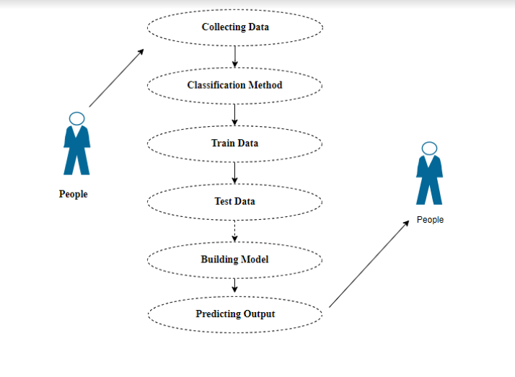
System Design – Use Case Diagram

Slide 15
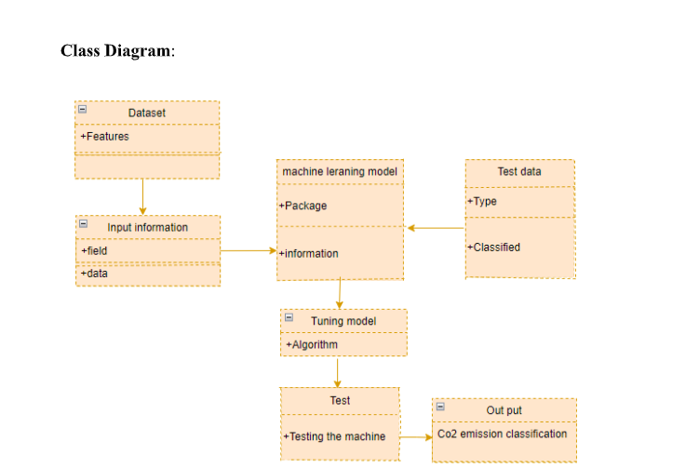
System Design – Class Diagram

Slide 16
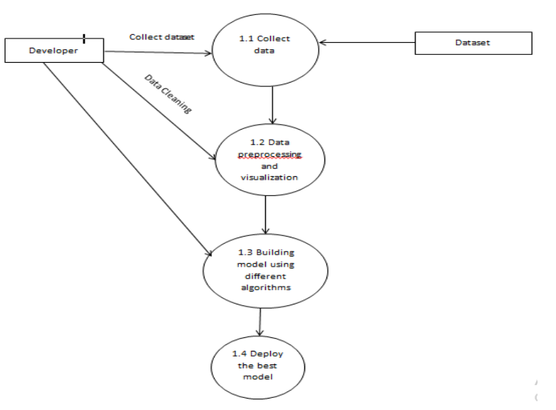
System Design – Data flow diagram

Slide 17
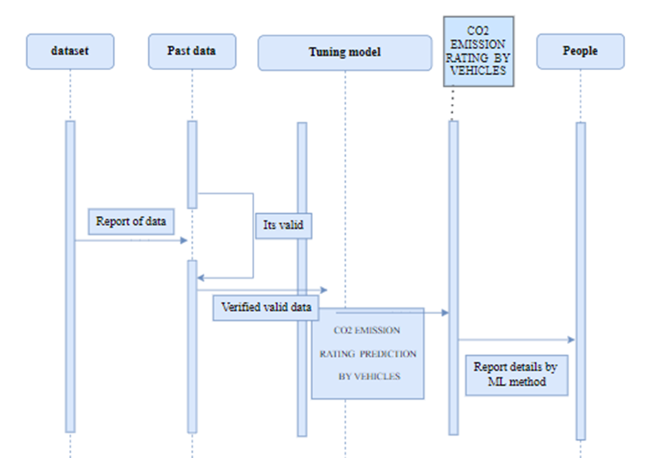
System Design – Sequence Diagram

Slide 18
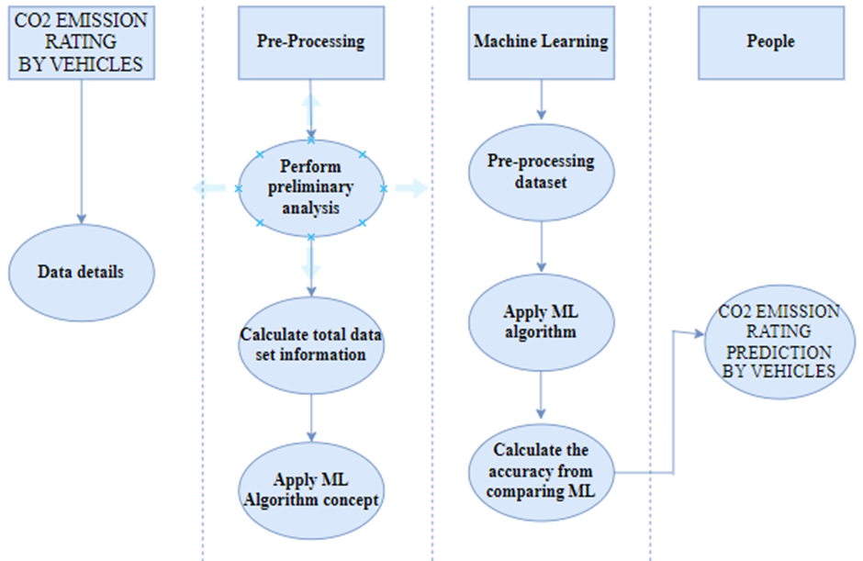
System Design – Activity Diagram

Slide 19
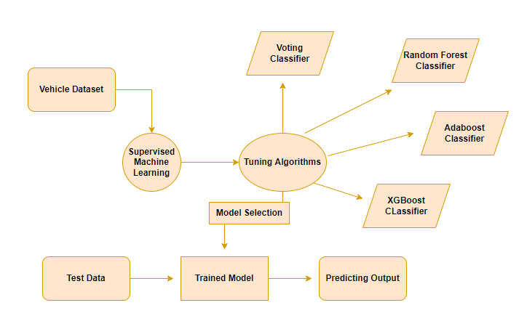
System Design – ER Diagram

Slide 20
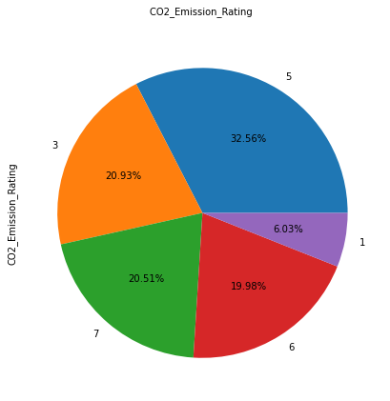
Module Description
Data pre-processing:
Data preprocessing is a technique that is used to convert the raw data into a clean data set. Stages of Data preprocessing:
Collected
Filtered
Sorted
Processed
Analyzed and stored
Data visualization:
The visual display of data using common graphs, charts, plots and etc. These visual representation helps to understand the complex data relationships
and data driven insights easily. Data visualisation is essential to data science
because it helps with complex data analysis, pattern recognition,
and the extraction of insightful information.

Slide 21
Module Description
RANDOM FOREST ALGORITHM:
Random forests or random decision forests are an ensemble learning method for classification, regression and other tasks, that operate by constructing a multitude of decision trees at training time and outputting the class that is the mode of the classes (classification) or mean prediction (regression) of the individual trees. Random decision forests correct for decision trees’ habit of over fitting to their training set.
The following are the basic steps involved in performing the random forest algorithm:
Pick N random records from the dataset.
Build a decision tree based on these N records.
Choose the number of trees you want in your algorithm and repeat steps 1 and 2.

Slide 22
Module Description
XG BOOST CLASSIFIER:
XGBoost (eXtreme Gradient Boosting) is a popular supervised-learning algorithm used for regression and classification on large datasets.
It uses sequentially-built shallow decision trees to provide accurate results and a highly-scalable training method that avoids overfitting.
It provides parallel tree boosting and is the leading machine learning library for regression, classification, and ranking problems.
It is a gradient boosting algorithm that uses decision trees as its “weak” predictors.

Slide 23
Module Description
ADA BOOST ALGORITHM:
An AdaBoost classifier is a meta-estimator that begins by fitting a classifier on the original dataset and then fits additional copies of the classifier on the same dataset but where the weights of incorrectly classified instances are adjusted such that subsequent classifiers focus more on difficult cases.
These are models that achieve accuracy just above random chance on a classification problem. The most suited and therefore most common algorithm used with AdaBoost are decision trees with one level.
It works on the principle of learners growing sequentially. Except for the first, each subsequent learner is grown from previously grown learners. In simple words, weak learners are converted into strong ones. The AdaBoost algorithm works on the same principle as boosting with a slight difference.

Slide 24
Module Description
VOTING CLASSIFIER:
A Voting Classifier is a machine learning model that trains on an ensemble of numerous models and predicts an output (class) based on their highest probability of chosen class as the output.
The idea is instead of creating separate dedicated models and finding the accuracy for each them, we create a single model which trains by these models and predicts output based on their combined majority of voting for each output class.

Slide 25
Module Description
Deploy:
In this module the trained machine learning model is converted into pickle data format file (.pkl file) which is then deployed in our flask framework for providing better user interface and predicting the output of how much the given data is emotions based on texts. The webpage takes voice as well as text input to recognize emotions. The voice input method is achieved using HTML and Javascript code.

Slide 26
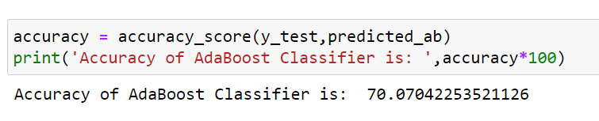
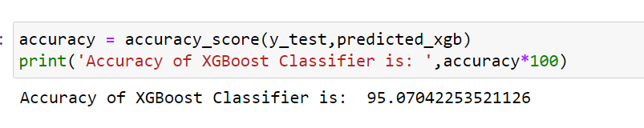
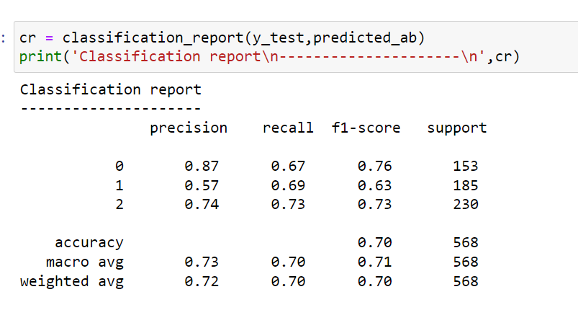
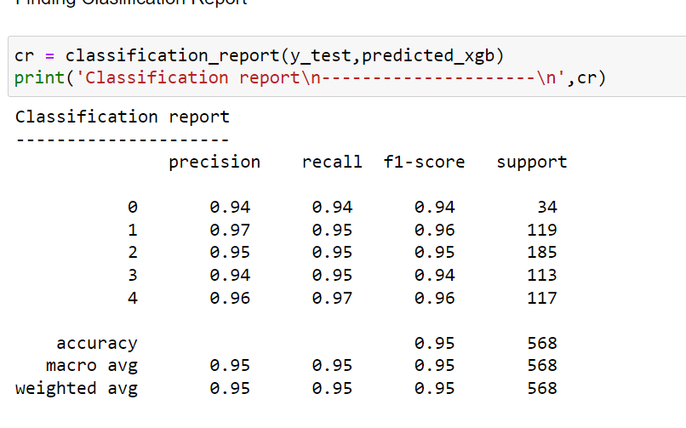
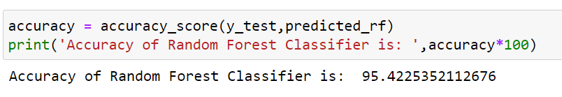
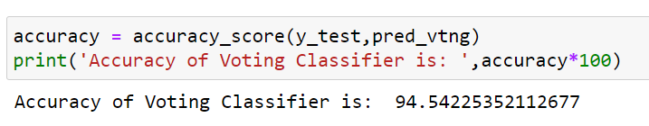
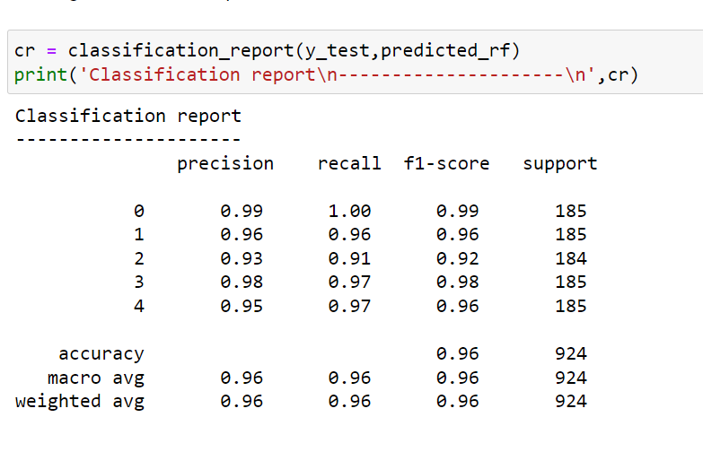
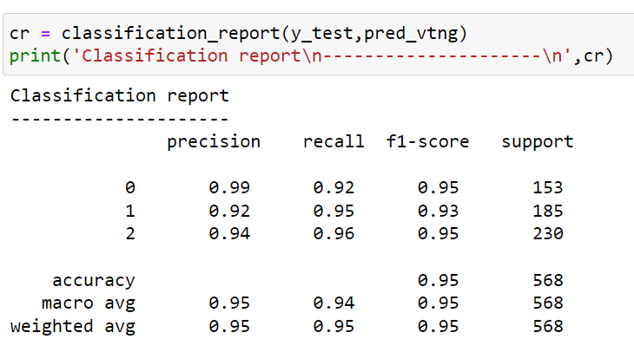
Performance Evaluation
1.
2.
3.
4.

Slide 27
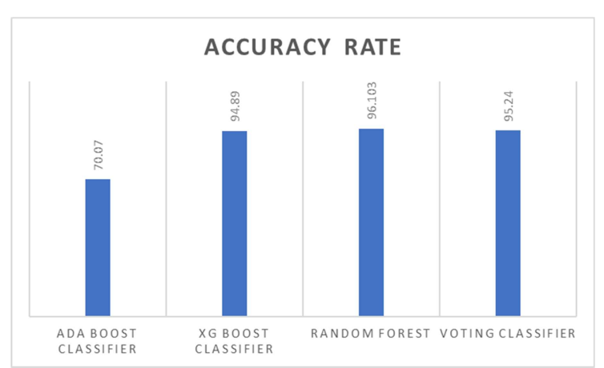
Performance Evaluation
Comparison of algorithms according to their accuracy rate

Slide 28
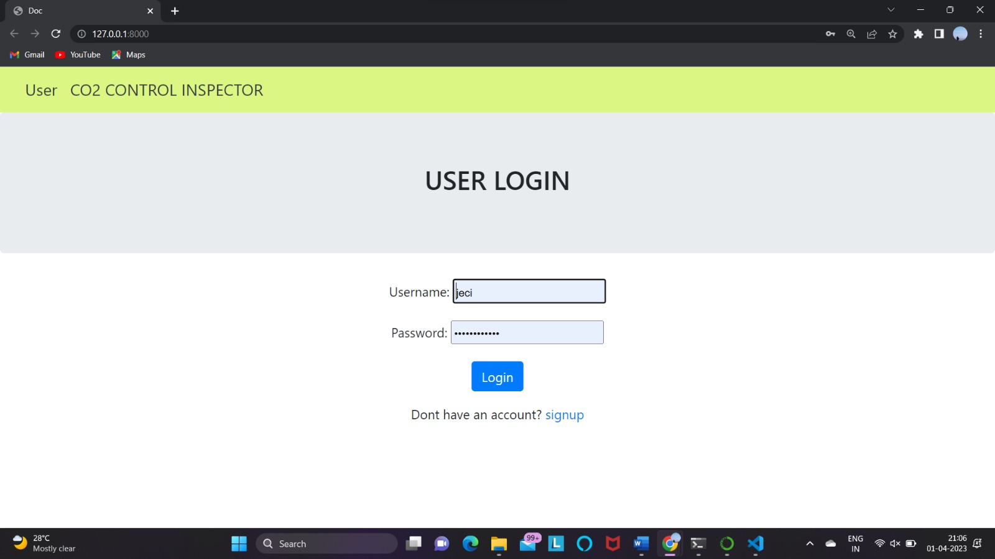
Screen Shots

Slide 29

Screen Shots

Slide 30
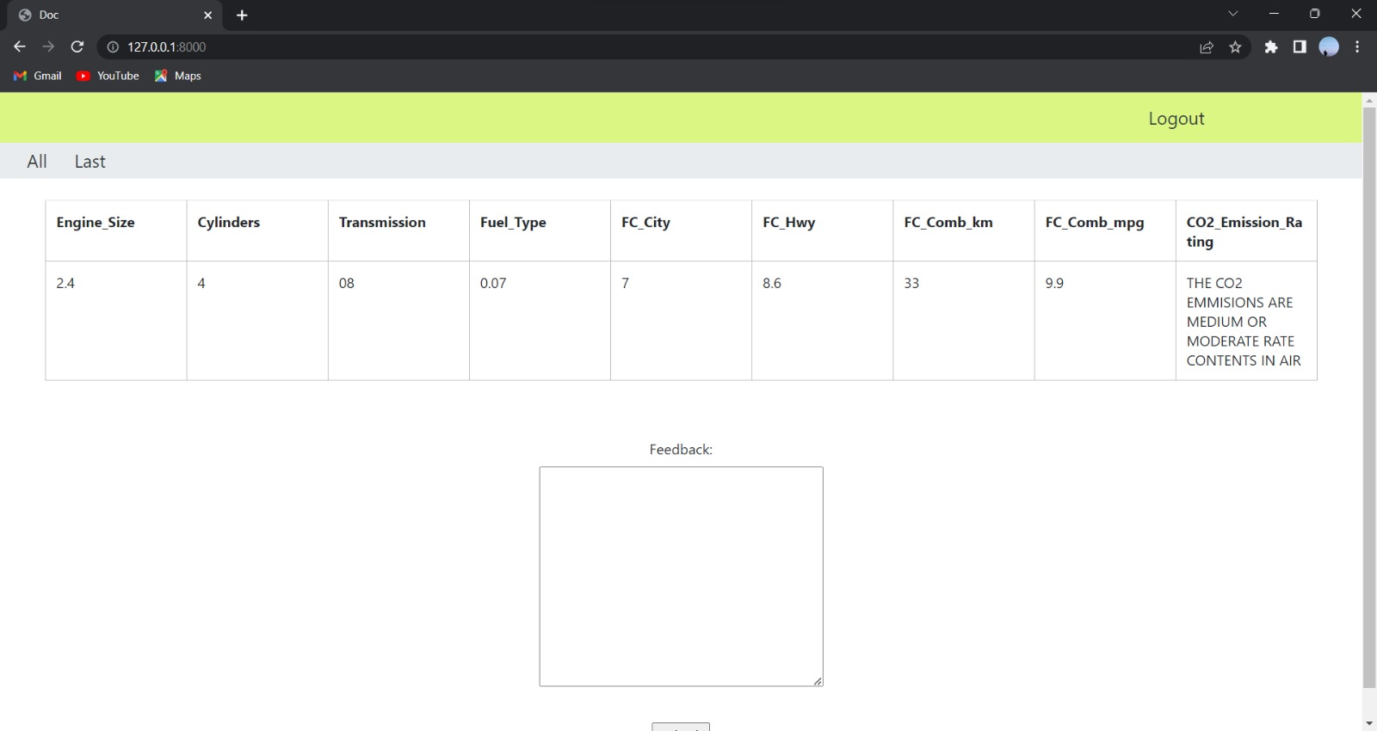
Screen Shots

Slide 31
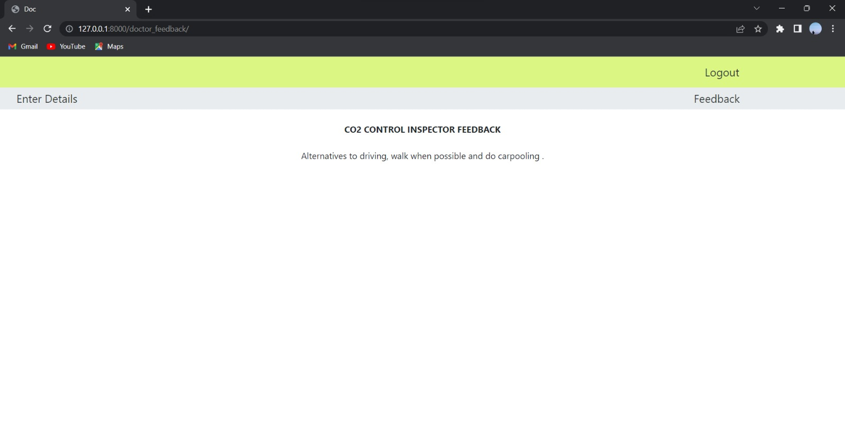
Screen Shots

Slide 32
Conclusion
In the modern world, there has been an immense usage of vehicles. And especially car has been used by majority of the people in the recent days. This has been the major and main cause for the emission of CO2 in the atmosphere which increases the global warming. In order to reduce the emission rate for the car that is used or the car that the user is going to buy, predicts the amount of CO2 emitted in the form of rates. As we have used the one of the best algorithms among the machine learning algorithms, Random Forest algorithm has given the best accuracy rate and the user interface has also been implemented for the better understanding about the model.

Slide 33
Reference Paper
[1] Sandeep Kumar, Pranab K. Muhuri: “A novel GDP prediction technique based on transfer learning using CO2 emission dataset” " Applied Energy 253 (2019)
[2] Tao Jia , Pengcheng Zhang, and Biyu Chen “A Microscopic Model of Vehicle CO2 Emissions Based on Deep Learning—A Spatiotemporal Analysis of Taxicabs in Wuhan, China” IEEE TRANSACTIONS ON INTELLIGENT TRANSPORTATION SYSTEMS,2022.
[3] Ngo Le Huy Hien and Ah-Lian Kor “Analysis and Prediction Model of Fuel Consumption and Carbon Dioxide Emissions of Light-Duty Vehicles” Appl. Sci. 2022, 12, 803.
[4] Huafang Huang, Xiaomao Wu and Xianfu Cheng “The Prediction of Carbon Emission Information in Yangtze River Economic Zone by Deep Learning” Land 2021, 10, 1380.
[5] Chairul Saleh, Nur Rachman Dzakiyullah , Jonathan Bayu Nugroho “Carbon dioxide emission prediction using support vector machine” IOP Conf. Series: Materials Science and Engineering 2015.

Slide 34
Reference Paper
[6] Artur Jaworski, Maksymilian Mądziel & Kazimierz Lejda “Creating an emission model based on portable emission measurement system for the purpose of a roundabout” Environ Sci Pollut Res 26, 21641–21654 (2019)
[7] L. Amarpuri, N. Yadav, G. Kumar and S. Agrawal, "Prediction of CO2 emissions using deep learning hybrid approach: A Case Study in Indian Context," 2019 Twelfth International Conference on Contemporary Computing (IC3)
[8] T. M. O. Santos, J. N. O. Júnior, M. Bessani and C. D. Maciel, "CO2 Emissions Forecasting in Multi-Source Power Generation Systems Using Dynamic Bayesian Network," 2021 IEEE International Systems Conference (SysCon)
[9] Sandeep Kumar, Pranab K. Muhuri: “A novel GDP prediction technique based on transfer learning using CO2 emission dataset” " Applied Energy 253 (2019)
[10] A. Cappiello, I. Chabini, E. K. Nam, A. Lue and M. Abou Zeid, "A statistical model of vehicle emissions and fuel consumption," Proceedings. The IEEE 5th International Conference on Intelligent Transportation Systems, Singapore, 2002

